Slide 1

ME 100 Final Project
Aashrith Beesabathuni
Kilian Cox

Slide 2

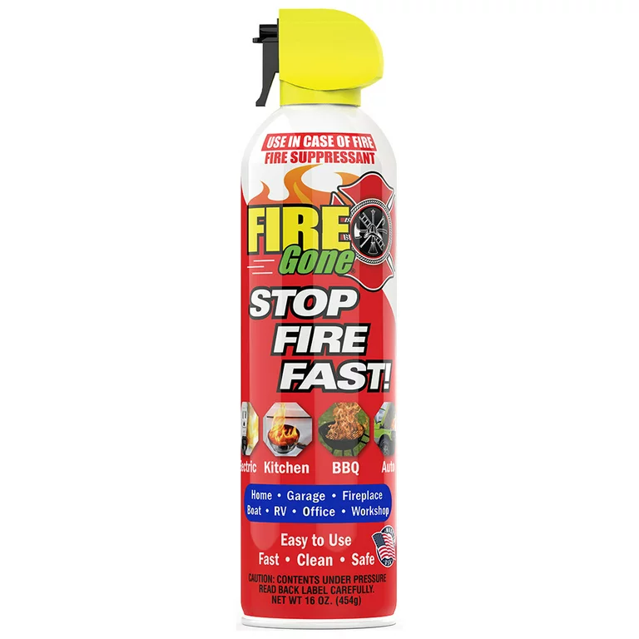
Overall Design
Image here
We wanted to create out final project so it would allow us to best demonstrate skills we learnt in ME100. To do so, we decided on creating an Automatic Fire Suppression System.
This device is mounted above a StoveTop, and is able to detect an unregulated fire on any of the 4 stoves, turn to that quadrant, and spray fire retardant spray till the fire is put out.

Slide 3
Overall Design (cont.)
Part 1: Actuation
Part 2: Computation
Part 3:
IOT
The most important part of the project is the can’s ability to spin 360 degrees. This is done through a belt-pulley system actuated by a motor attached to the can.
The computation part of the project comes from the calculator of what position the can needs to go. Based on the readings of the fire-sensors, the ESP32 will calculate how far to spin to reach the desired position.
After initially receiving a signal from the fire sensor, the device will send the user a text to warn them of the hazard, and also a text when the first is put out!

Slide 4
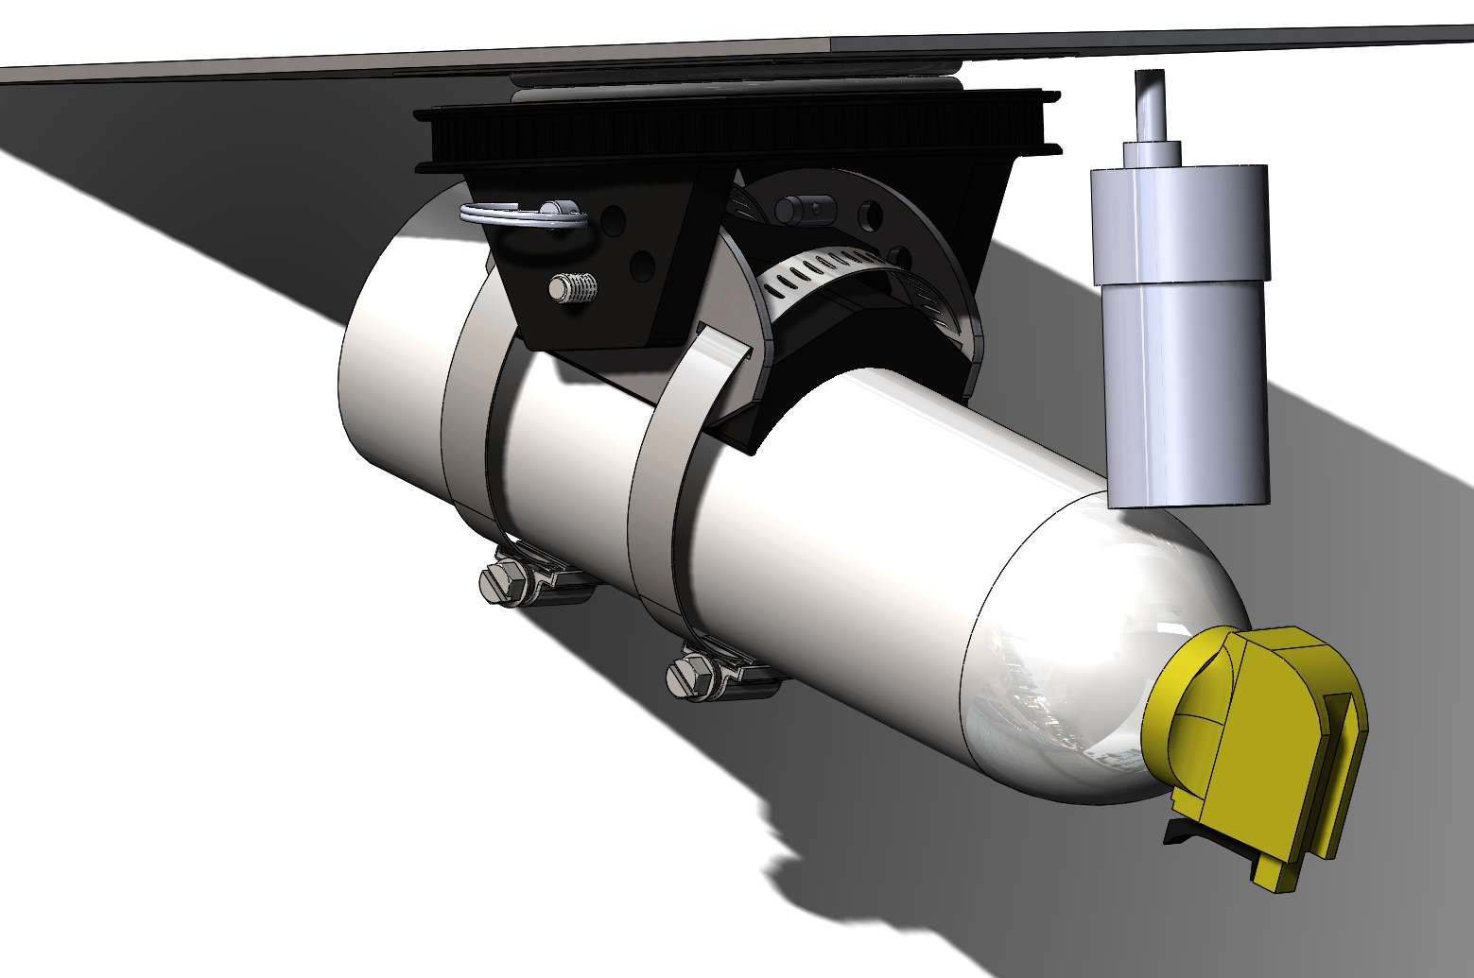
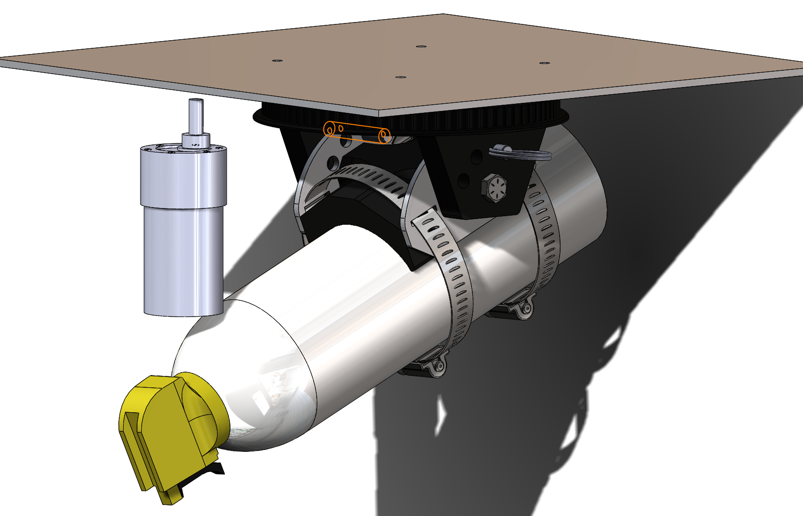
CAD Images

Slide 5
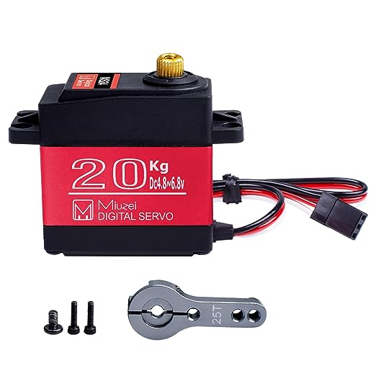
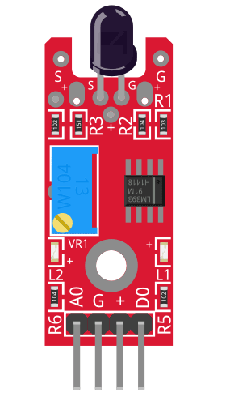
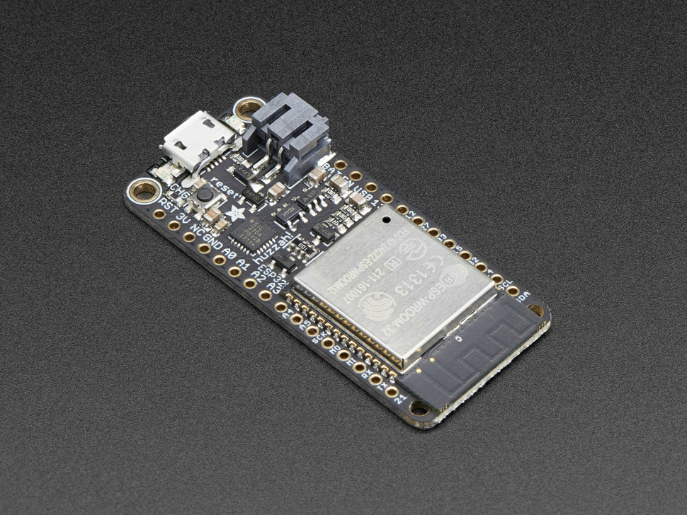
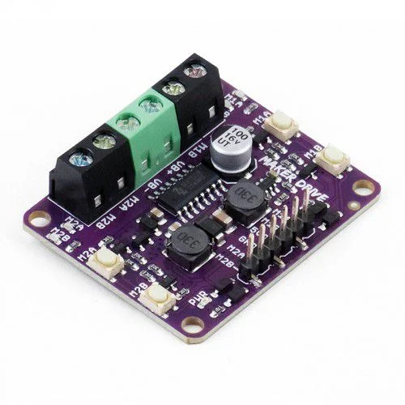
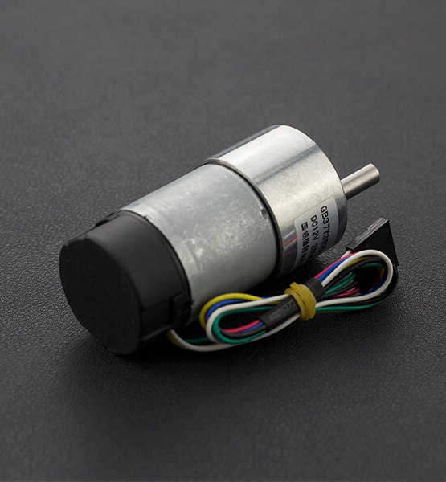
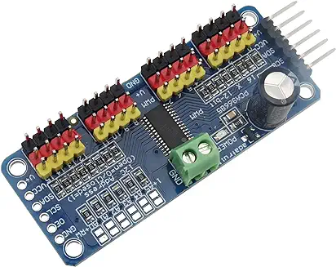
Electronic Components
K-026 Flame Sensor to detect where the fire is
ESP32 used as main microcontroller to receive and compute data
DC Servo + Controller for activating trigger
DC Geared Motor w encoder used to actuate the can to desired position
MakerDrive Motor Drivers to control actuation accurately

Slide 6
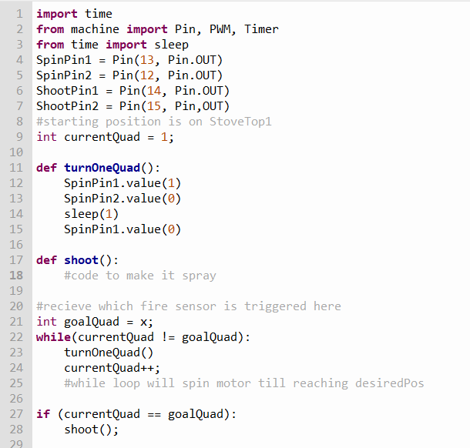
Initial Code

Slide 7
Future Plans
Implement Sensors
Test Rotation Speed
Ordered recently, will attempt to integrate them and read their values
See how fast we are able to spin to put out fires
Implement IOT
Manufacture Parts
Send Text message after fire is detected, and eventually put out
WaterJet main plate, 3D print most of the structural parts,
Cad Finalizing
Belt / Pulley System finishing
Trigger Mechanism
Hardware

